Slide 1


Store Sales Review
Q1-Q4 2015

Slide 2
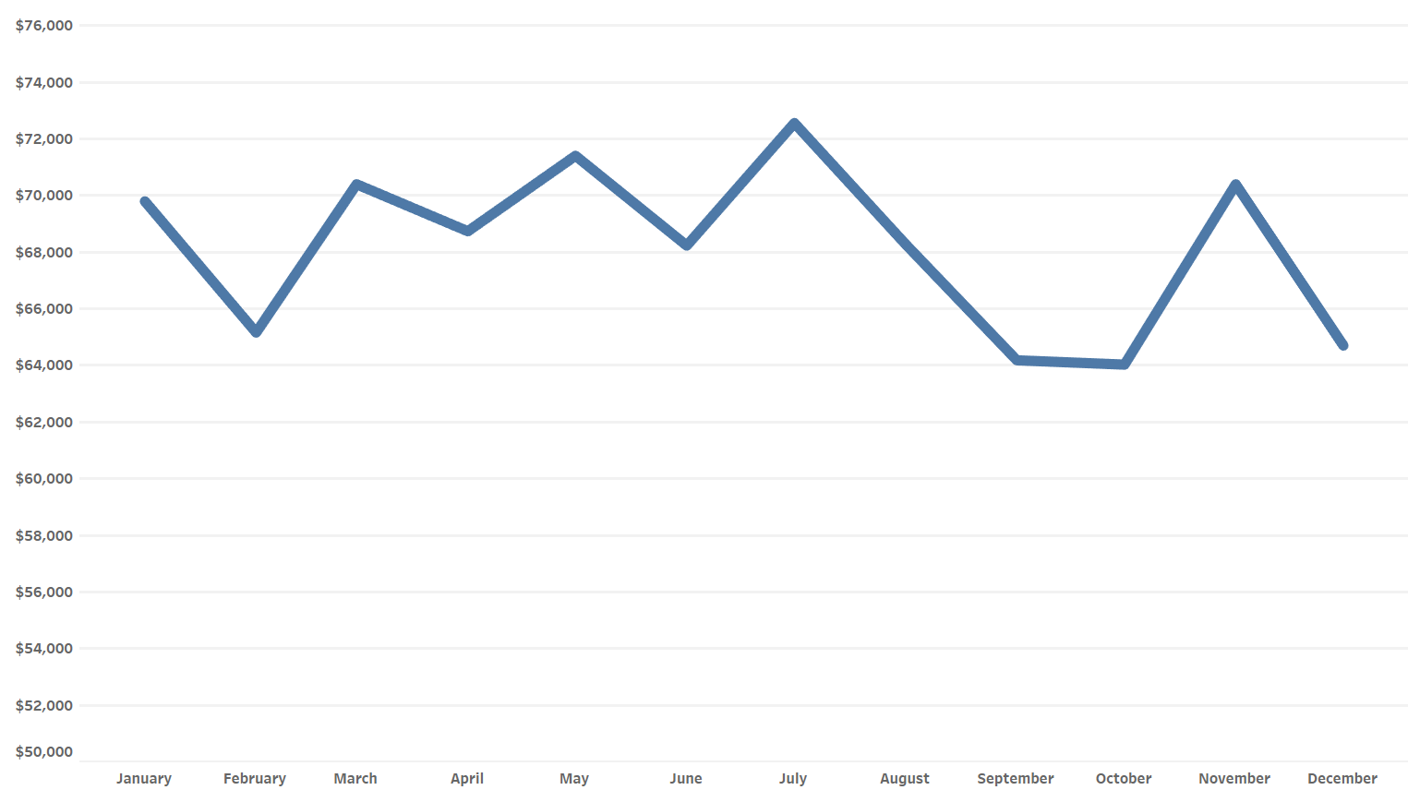
Total Monthly Sales
August – October Lull
August – February is a larger
scale sales lull broken by
spikes in November and January

Slide 3
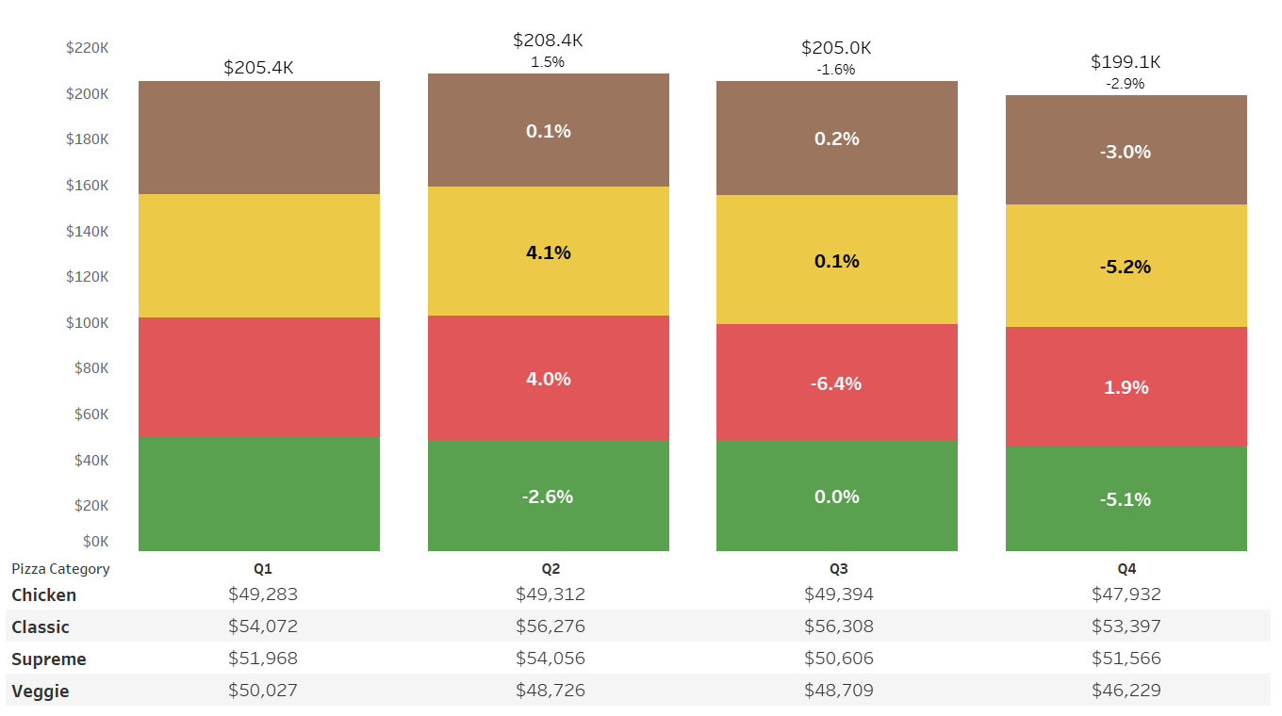

Category – Quarterly Sales by Pizza Type
Supreme product sales drop in Q3 created a negative sales growth for the quarter
Classic and Supreme sales spiked in Q2
Veggie sales decrease throughout the year

Slide 4
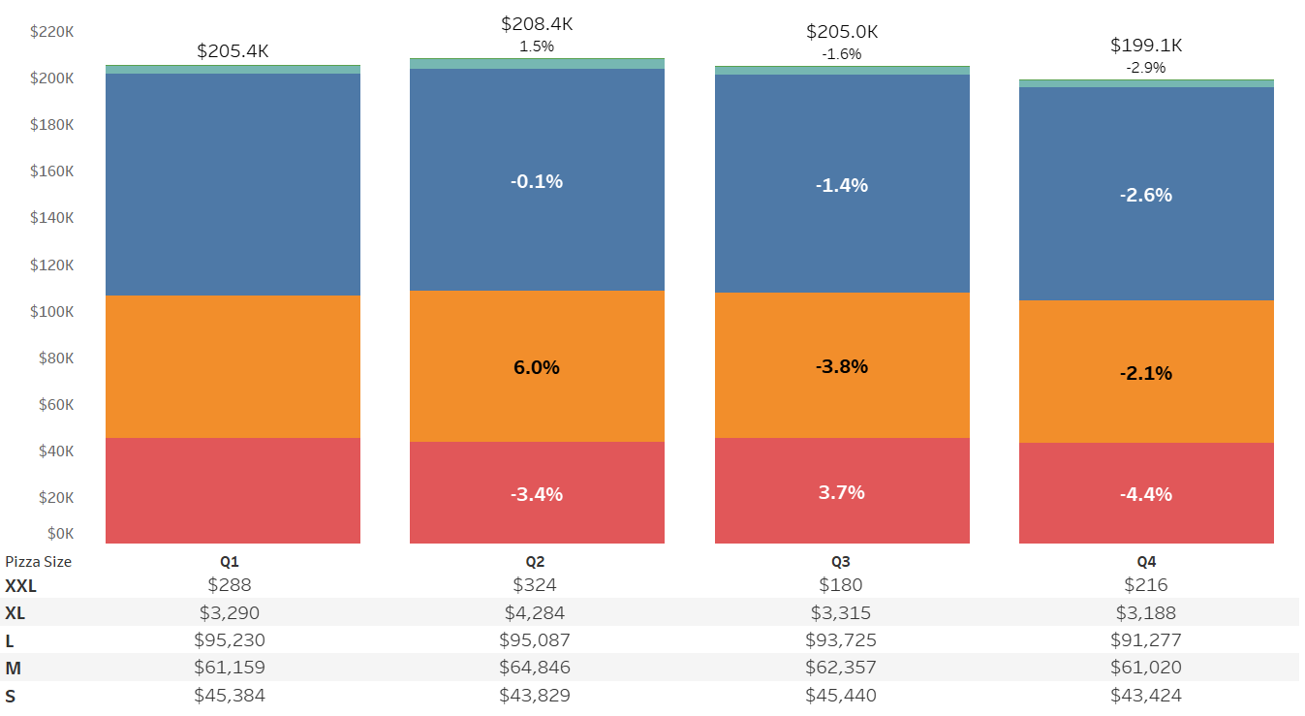

Size – Quarterly Sales by Pizza Size
Significant shift in Q2 away from Small towards Medium
Small and Medium don’t often
follow overall quarterly sales
like Large does

Slide 5
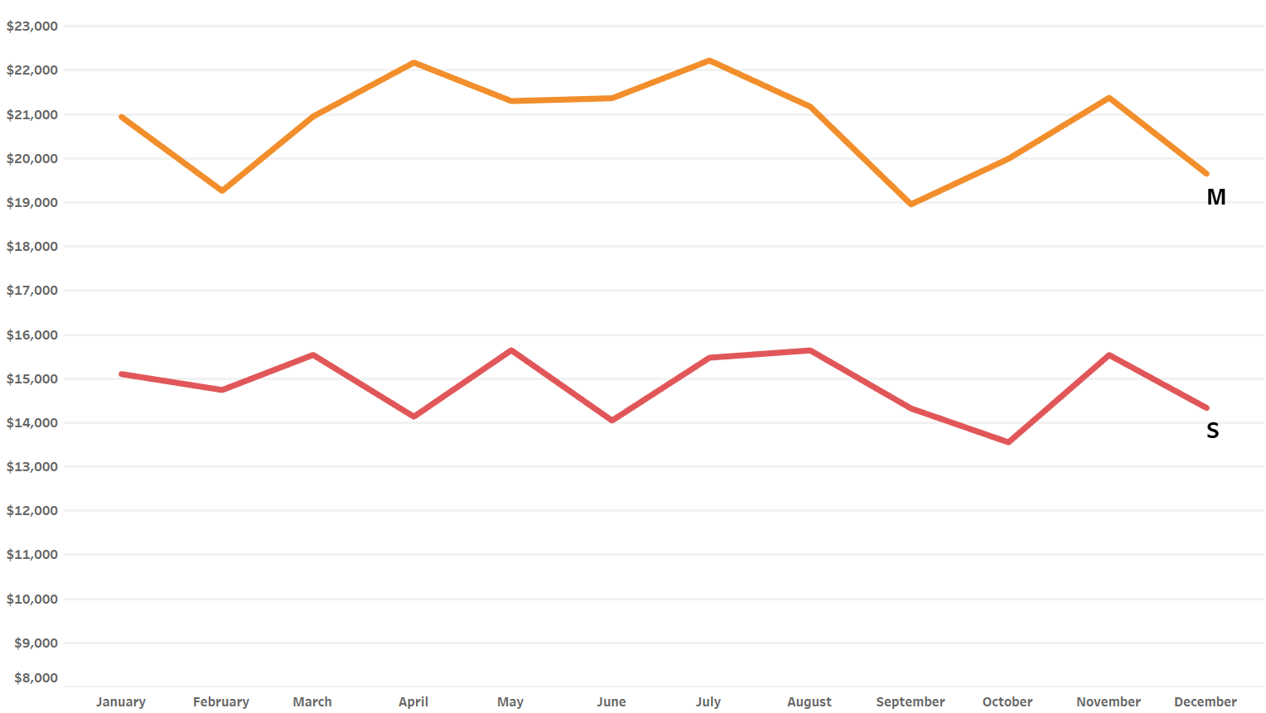
Small and Medium Pies Per Month
The Q2 spike of Mediums spans March to July
Without May, Small’s Q2 dip would have been more severe
Small and Medium hit their lows at different times in the store’s
total sales lull

Slide 6
Summary
Focus on maintaining Supreme Pizza sales going into this coming Q3.
A promotion starting in August and lasting a few months will help create yearly sales growth.
Ideas include: Back to school special, NFL season start special
To account for the sales dip of Medium pizzas in September and Small pizzas in October, this promotion
should be dynamic and adjust to push sales of each type in their respective dip month.
Overall, a promotion August – October that focuses on Supreme pizzas while giving
special attention to Medium pizzas in September and Small pizzas in October
should improve the sales lull we see in those months.

Slide 7

Thank You!
Questions?

